Slide 1

CS 533 INTRO TO DATA SCIENCE
Michael Ekstrand

Slide 2
MULTIPLE LINEAR REGRESSION

Slide 3

Learning Outcomes
Build models with 2 or more predictors
Compare models using the Adjusted R² and AIC
Photo by Jen Theodore on Unsplash

Slide 4
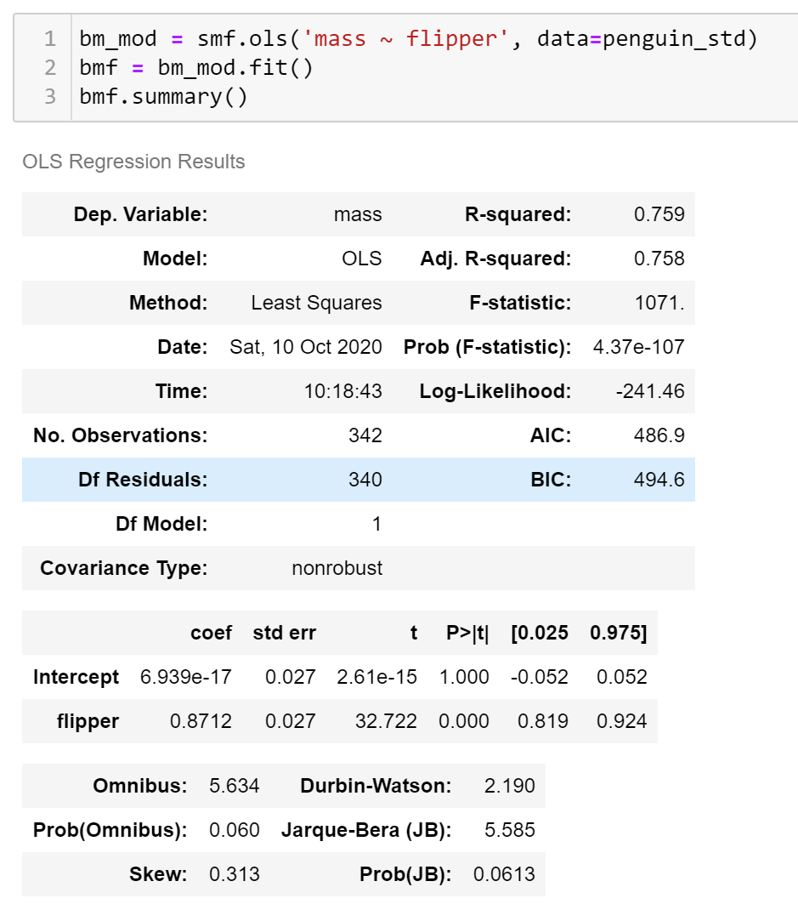
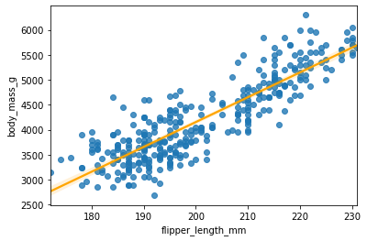
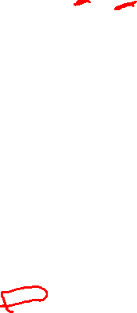
Base Model

Slide 5
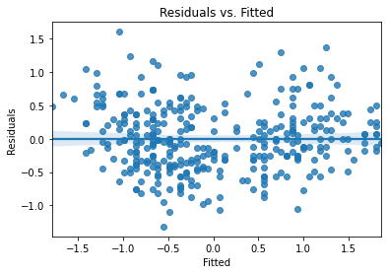
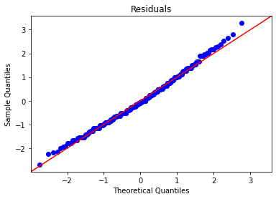
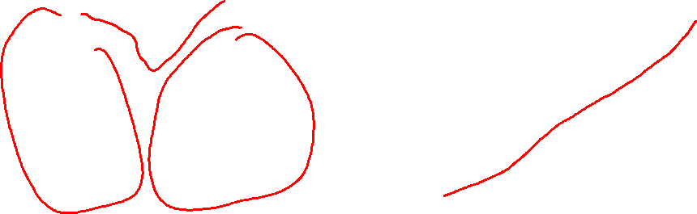
Assumption Checks

Slide 6
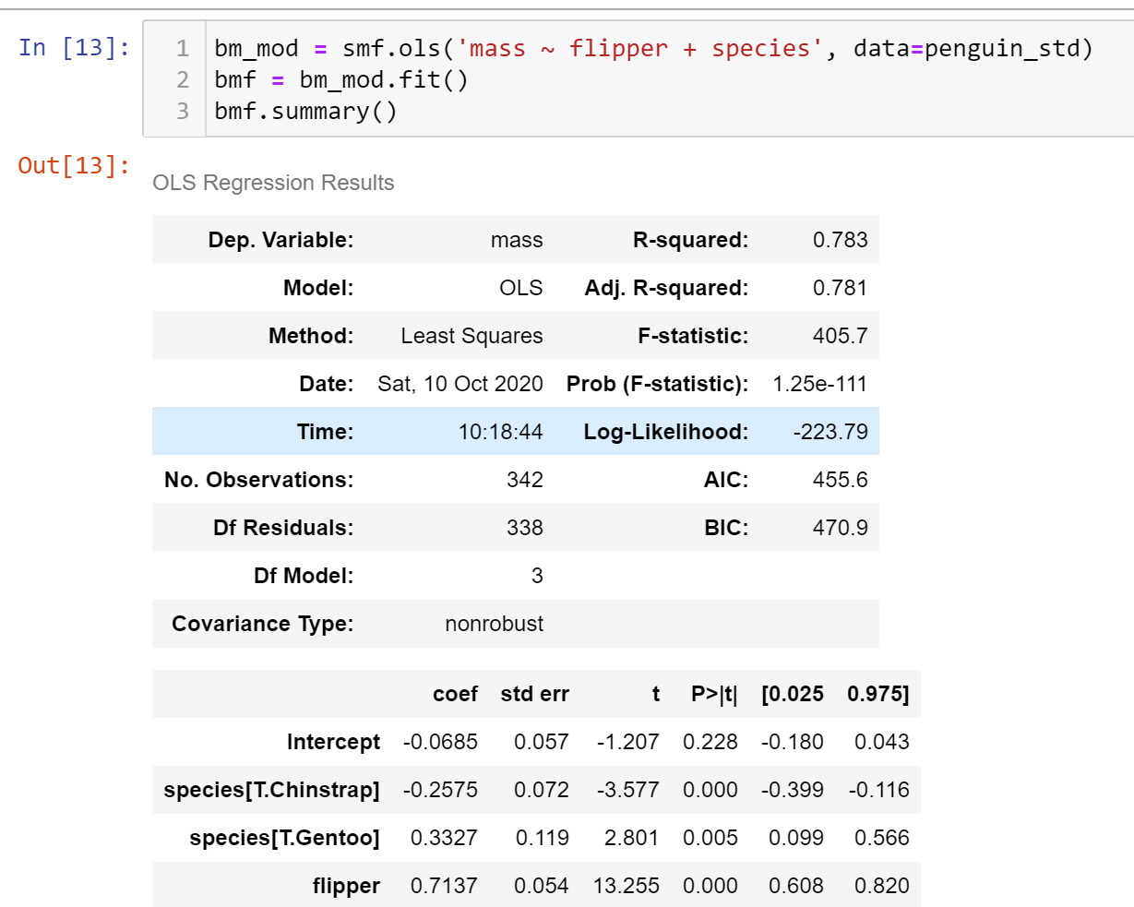
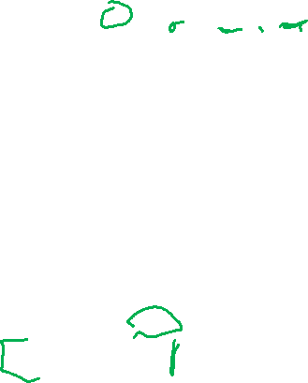
Adding Species
Do different species have different flipper lengths?
Formula API automatically dummy-codes species.
Intercept: baseline Adelie mass
Species: increase/decrease in baseline mass for each species

Slide 7

Adding Species
Adjusted R² for multivariate regression
Adjusts for multiple variables
AIC compares models for same predictor – lower is better fit
Combines estimation power with model complexity

Slide 8
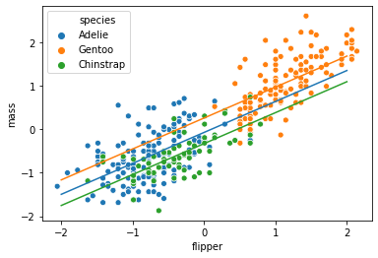
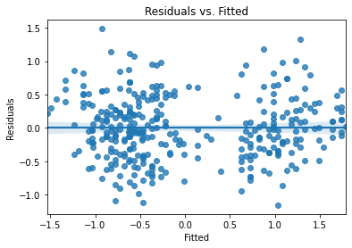
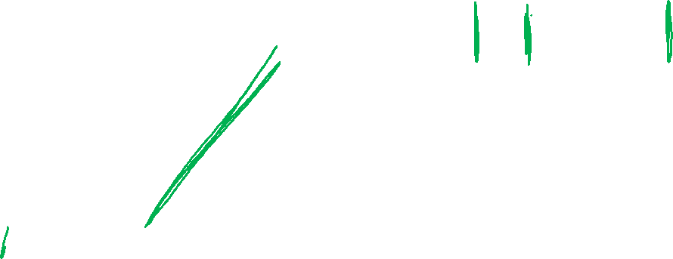
Plot & Residuals

Slide 9
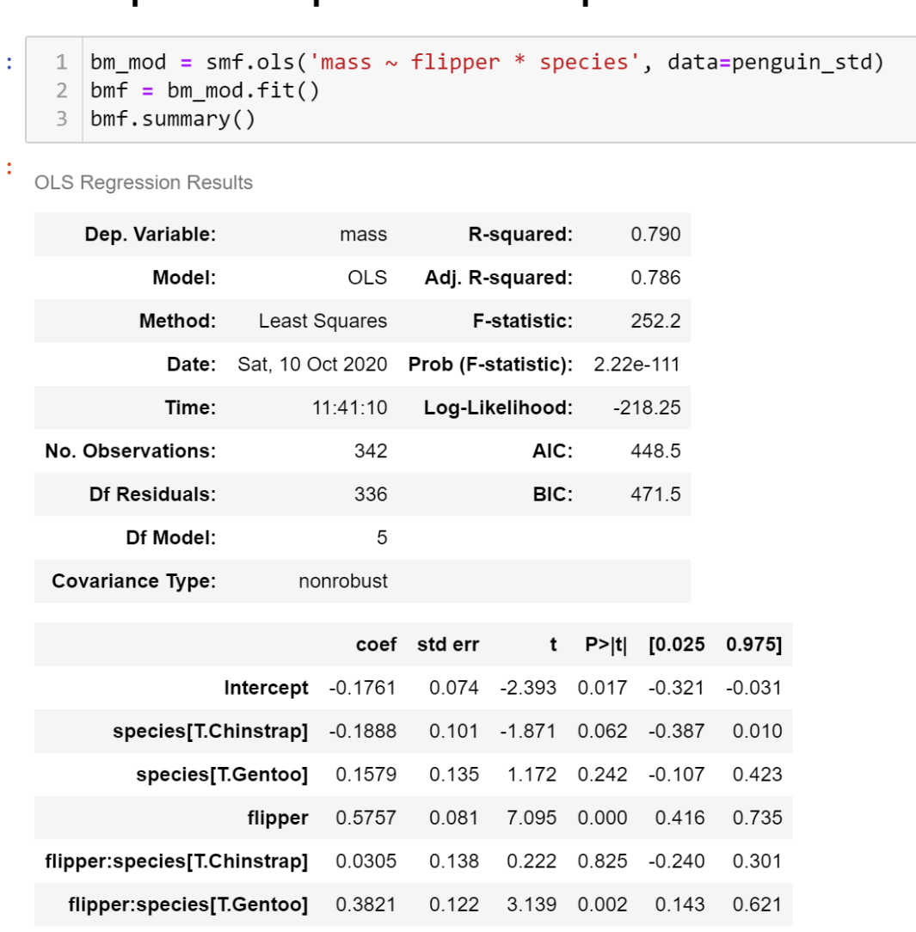
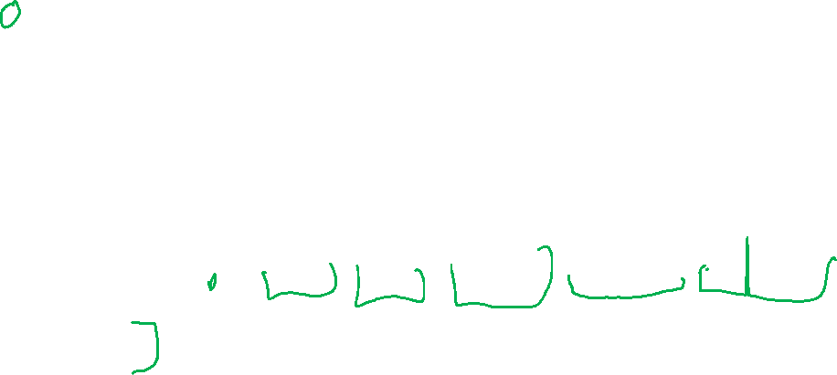
Interaction Effects
Interaction effects apply to products of variables
Categorical + Numeric: adjust slope by category
$$\hat{y}=β_{0}+β_{1}x_{c}+β_{2}x_{g}+β_{3}x_{flip}+β_{4}x_{c}x_{flip}+β_{5}x_{g}x_{flip}$$

Slide 10
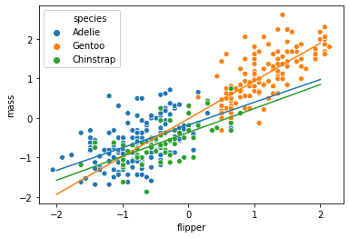
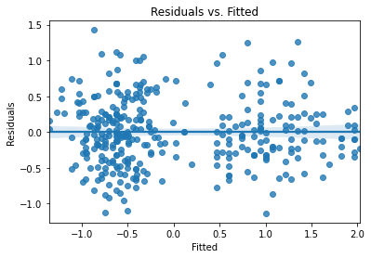
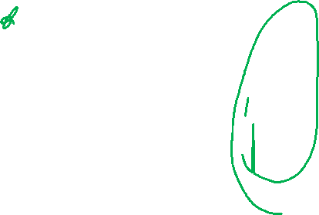
Plot & Residuals

Slide 11
Specifying Main and Interaction Effects
Main effect – effect of the variable(s) on their own
Specified with V1 + V2 + … + Vn
Interaction effect – interaction (product) of variables
Specified with V1:V2
Full effects – main and interaction
Specified with V1 * V2
Expands to V1 + V2 + V1:V2

Slide 12
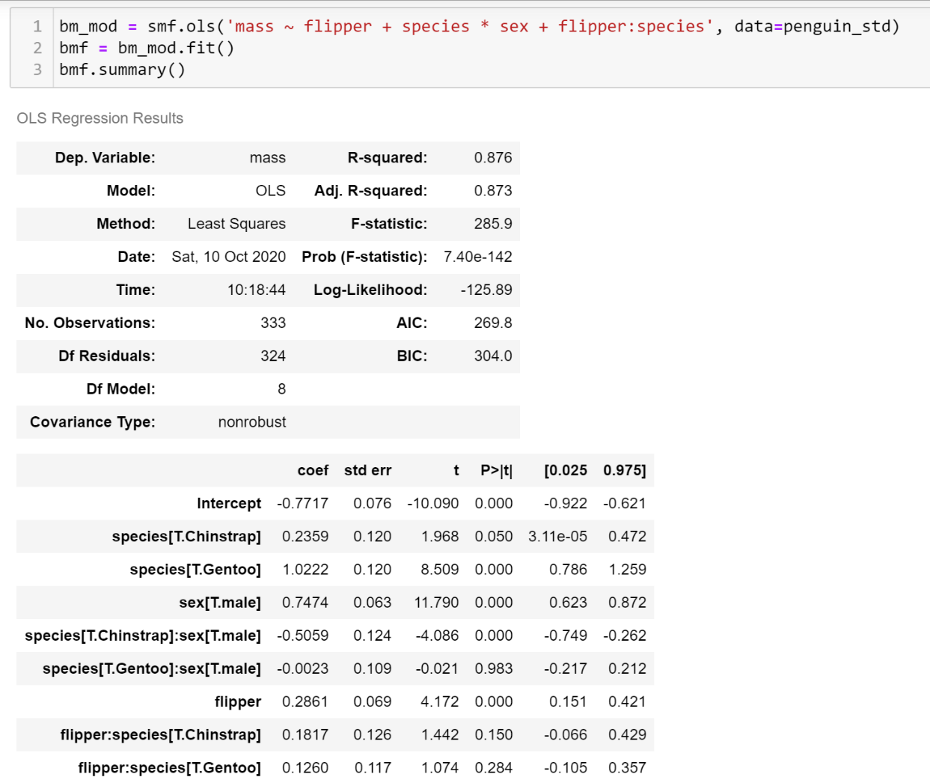
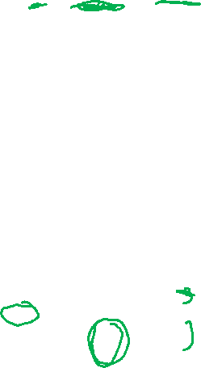
Sexual Dimorphism
Flipper/species interaction not significant
After accounting for species and sex differences, data does not support different flipper/mass slopes for different species.

Slide 13
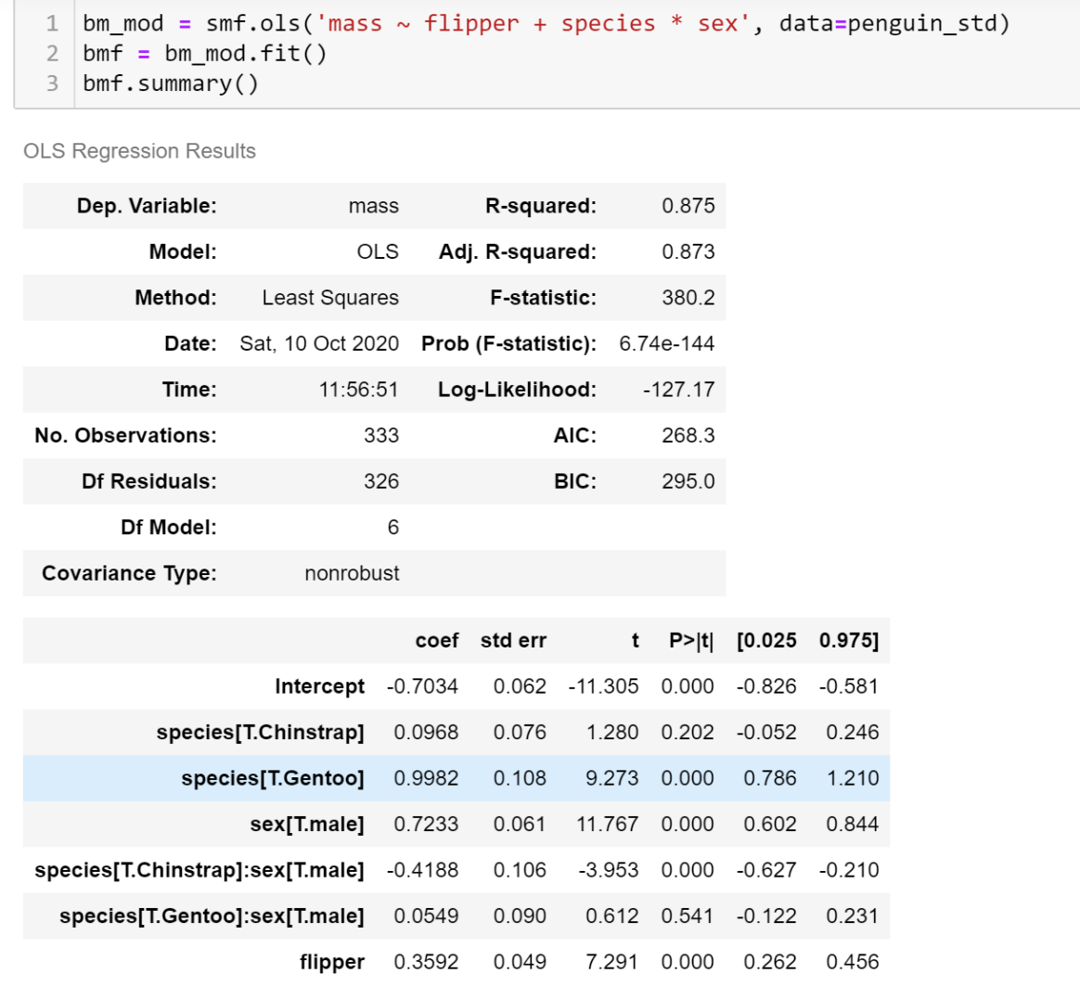
Simplified
Slightly better AIC
Same Adj. R²
Species & Sex have subtle interpretation
Most of the chinstrap difference is that male chinstraps are smaller
Gentoos and Adelies likely have the same mass dimorphism

Slide 14
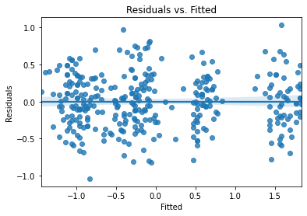
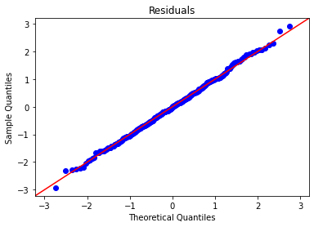
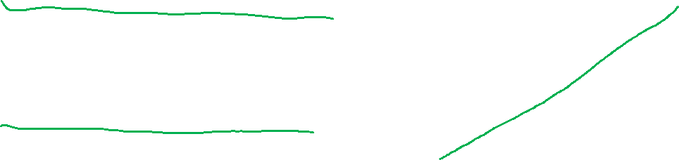
Assumption Checks

Slide 15
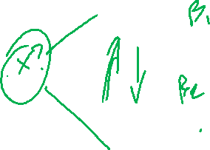
Beware Correlated Predictors
Correlated predictors cause poor model fits
Problem is called multicollinearity
X₁
X1 causes X2?
X2 causes X1?
X? causes X1 and X2?
Which coefficient gets the common effect?
Can even invert signs!
Y
X₂

Slide 16
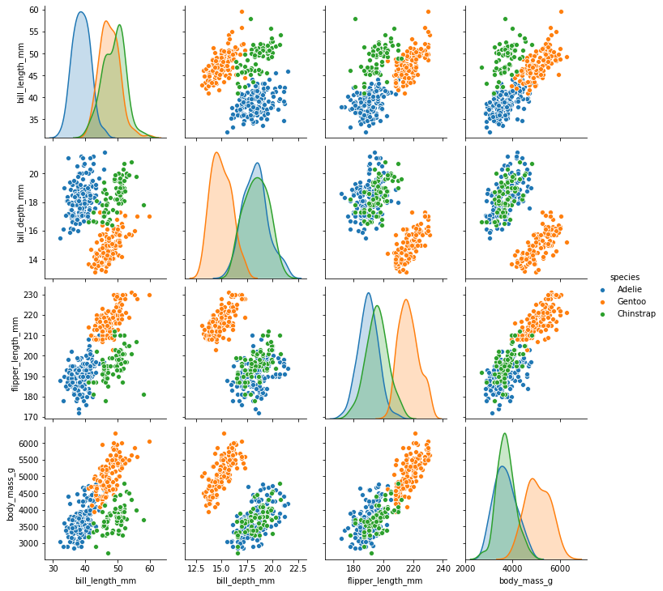
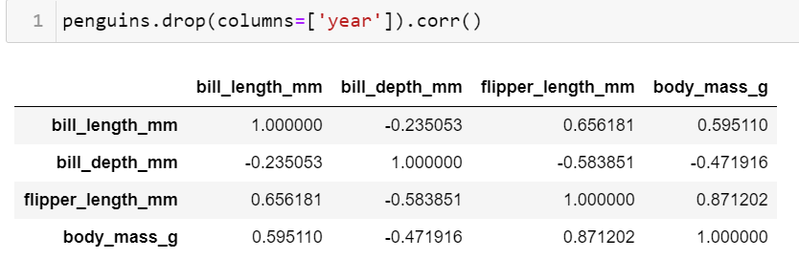
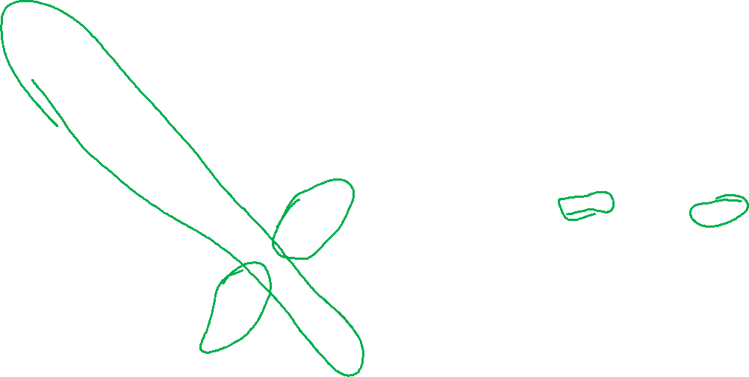
Pair Plot – useful for detecting correlations
Also use a correlation matrix.

Slide 17
Occam’s Razor
Given two explanations, prefer the one with fewer assumptions
Application to modeling:
Prefer simple models
Features and complexity need to earn their keep
AIC is one embodiment of this.

Slide 18

Wrapping Up
Linear models can extend to multiple variables.
We can look at separate (main) and interaction effects.
Prefer simple models.
Photo by Luís Eusébio on Unsplash

